Slide 1
Recurrent Neural Networks

Slide 2
Outline
What is an RNN
RNN Types
Vanishing/Exploding Gradient Problem
Long Short Term Memory Networks
Conclusion

Slide 3

What is an RNN

Slide 4
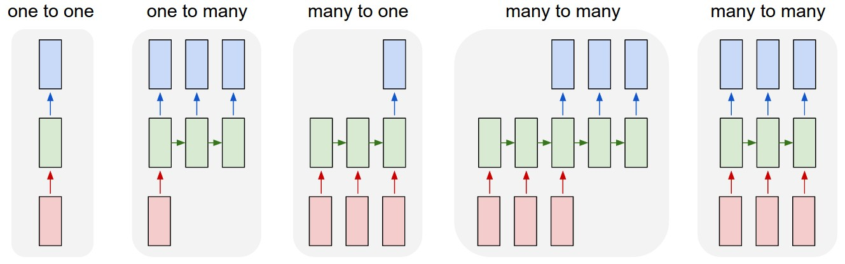
RNN Types

Slide 5
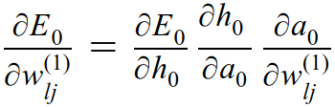
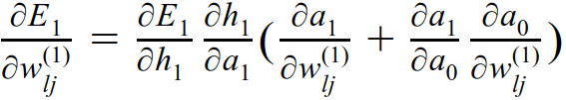

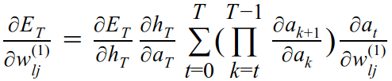
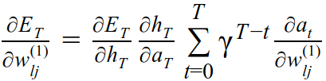
Vanishing/Exploding Gradient Problem

Slide 6
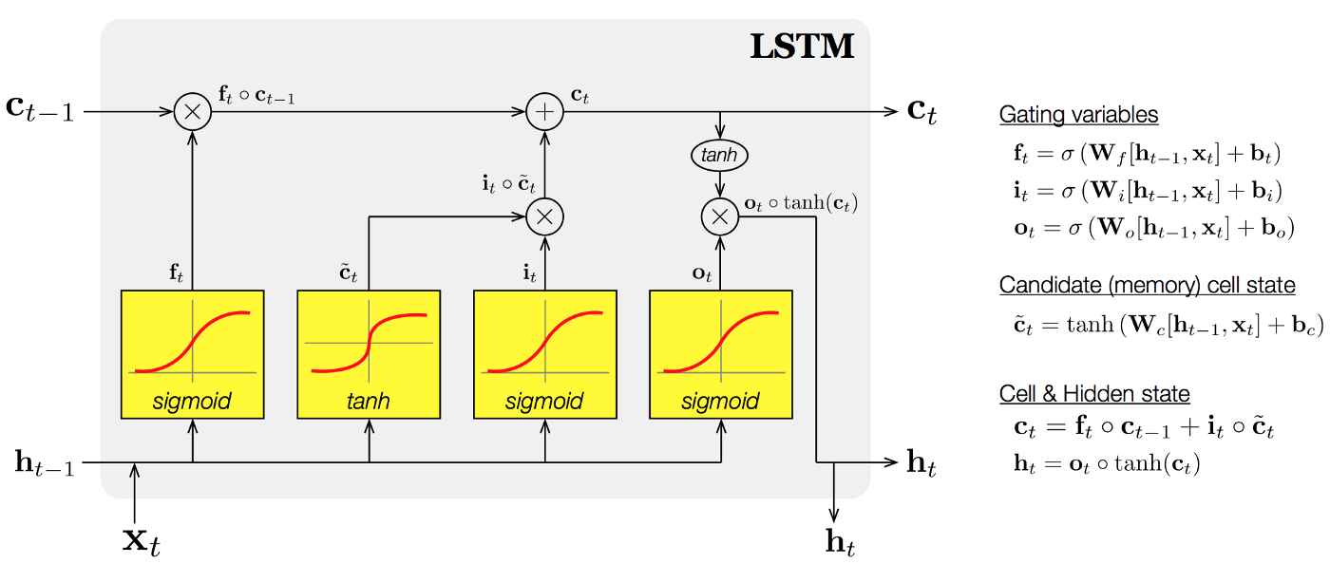
Long Short Term Memory Networks

Slide 7
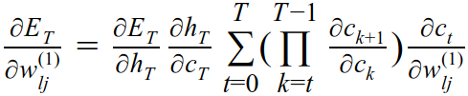
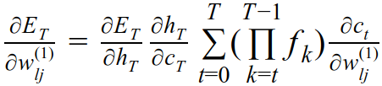
Long Short Term Memory Networks

Slide 8
Conclusion
RNNs can be used in different ways that serve different applications
They propagate their state which gives them memory
But they suffer from vanishing/exploding gradients
LSTMs alleviate the problem by gating the cell state

Slide 9
Questions?

Slide 10
References
https://medium.com/@jianqiangma/all-about-recurrent-neural-networks-9e5ae2936f6e
http://karpathy.github.io/2015/05/21/rnn-effectiveness/
https://www.youtube.com/watch?v=56TYLaQN4N8
https://codeburst.io/generating-text-using-an-lstm-network-no-libraries-2dff88a3968

